Slide 1
Dataspace DevOps
Architecture & Build

Slide 2
Summary
What is DevOps?
Environments
Team & responsibilities
Current & Future process in place
The DevOps platform
CI/CD processes
Quality controls
Documentation & Links

Slide 3
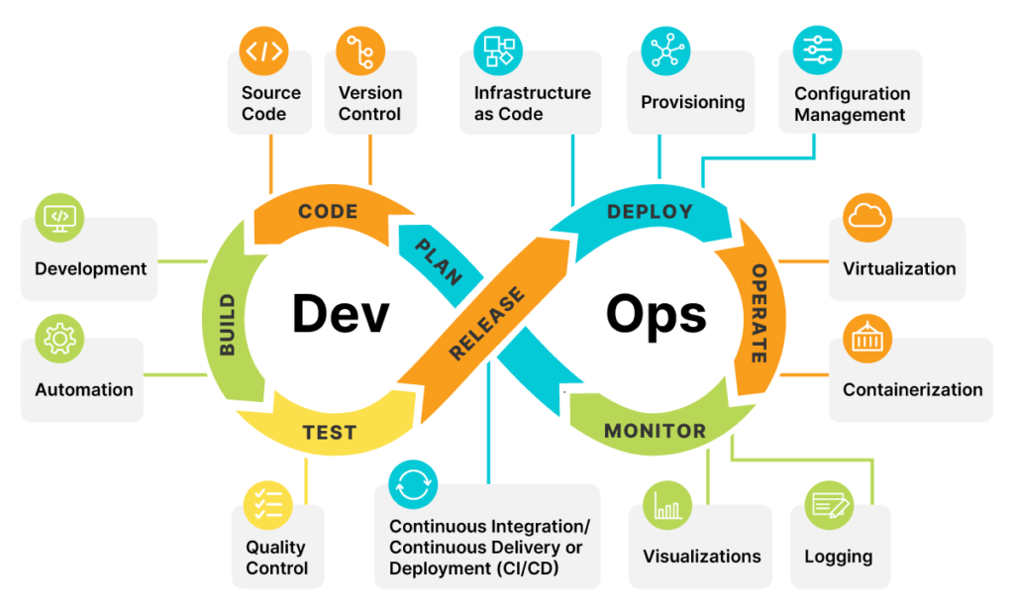
What is DevOps?
Is a methodology to improve work throughout the software development lifecycle

Slide 4
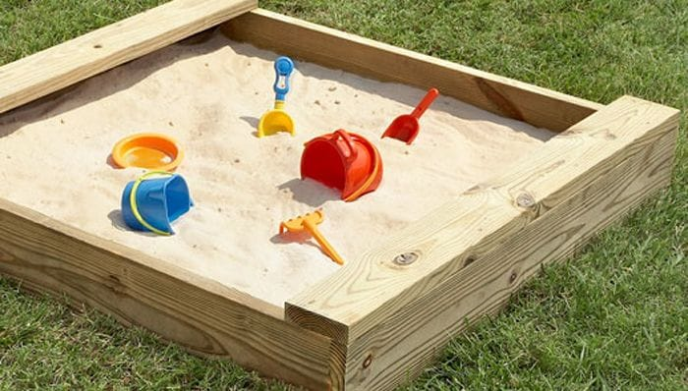
Environments
Current Azure environment
rg-sandboxsia-poc-001

Slide 5
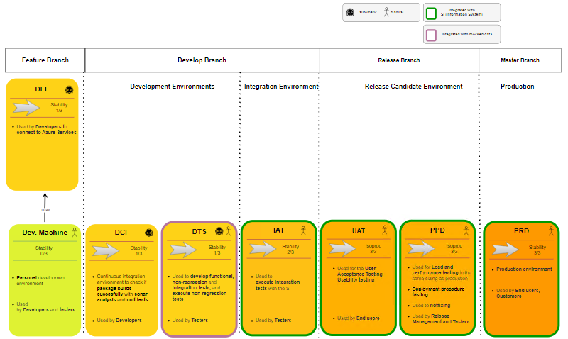
Environments
Future Azure environments

Slide 6
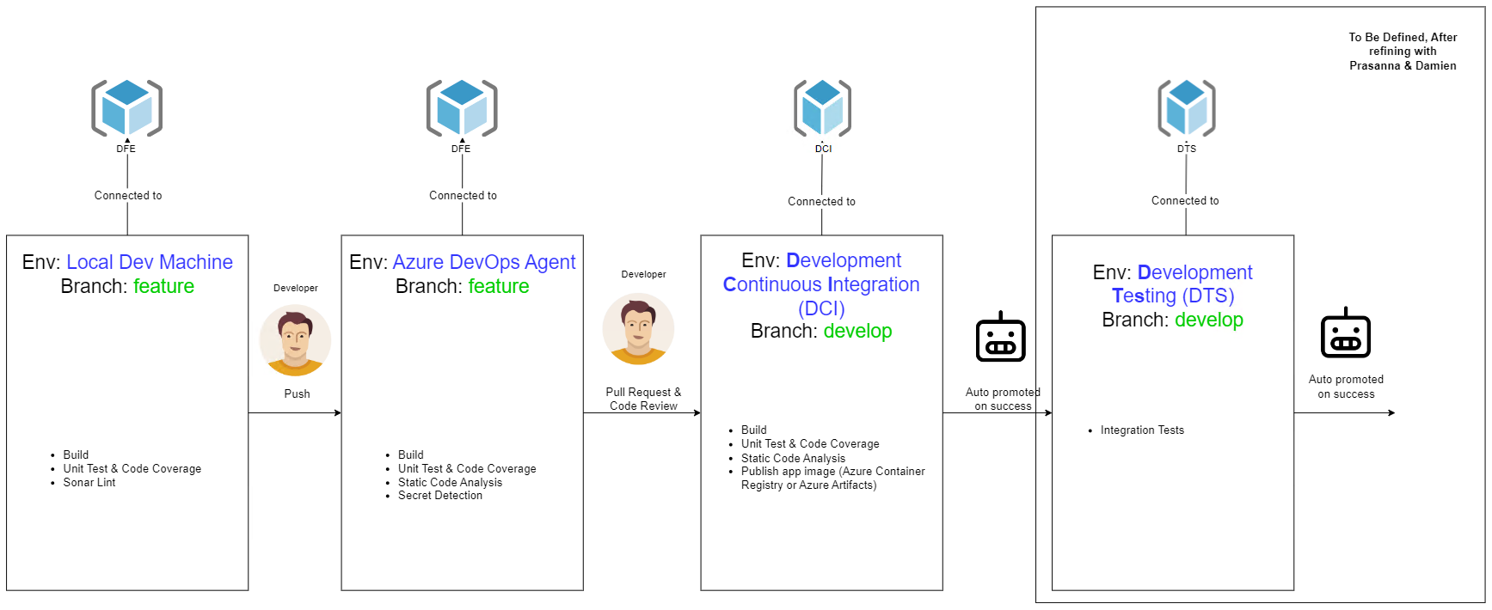
Environments
Future Azure environments

Slide 7
Environments
Environment transition - DCI
DCI (Development continuous integration)
Is a developer environment that contains all developed features altogether
Where we are:
Infrastructure deployed on Azure
DevOps pipeline in place
Private network access to developers
Monitoring/Logging

Slide 8
Environments
Environment transition - IAT
IAT (Integration acceptance testing)
Is where other systems do integration testing
Where we are:
Infrastructure deployed on Azure
DevOps pipeline in place
Private network access to testers
Monitoring/Logging

Slide 9

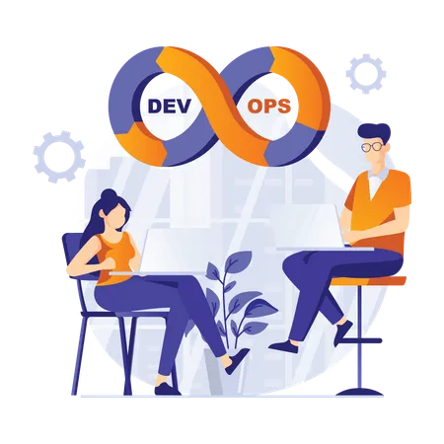

Team & responsibilities
Team
Dev Leaders: S. Rousseau, H. Alves, J. Issartel
Devs: Catalina, Jonathan, Ahmed, Guy, Christophe, etc.
DevOps: X. Klausener, S. Riquen (backup)
Testers: Nirmann, Nita

Slide 10
Team & responsibilities
Responsibilities
Task | Devs | Dev Leaders | Testers | DevOps
Source code organization, branch creation, prs | R | A/R | I | C
Application deployment on DCI | R | A/R | I | C
Application deployment on other envs: DTS, IAT, UAT, PPD | I | I | I | A/R
Application coding language choice and runtime dependencies | C | A/R | I | C
Unit Testing tooling | R | A/R | I | C
Integration testing tooling | I | C | A/R | C
Continuous integration automation | C | C | I | A/R
Creation/manipulation of Azure infrastructure (ex: new db, event hub, storage account, access rights) | I | R | I | A/R

Slide 11
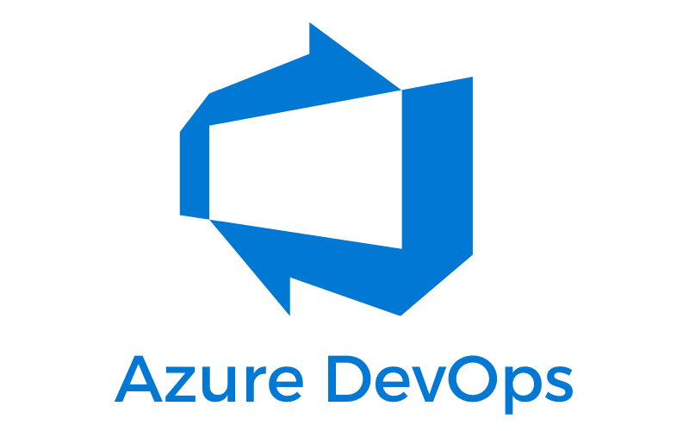
The DevOps platform
Source code in Azure DevOps repositories
CI/CD pipelines in Azure pipelines
Maven artifacts in Azure artifacts

Slide 12
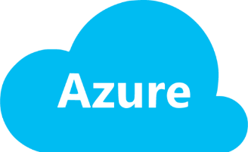
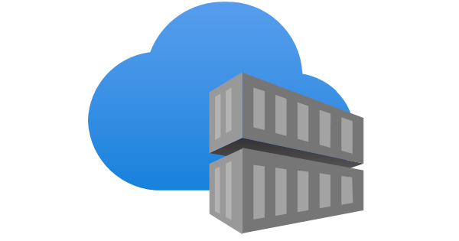
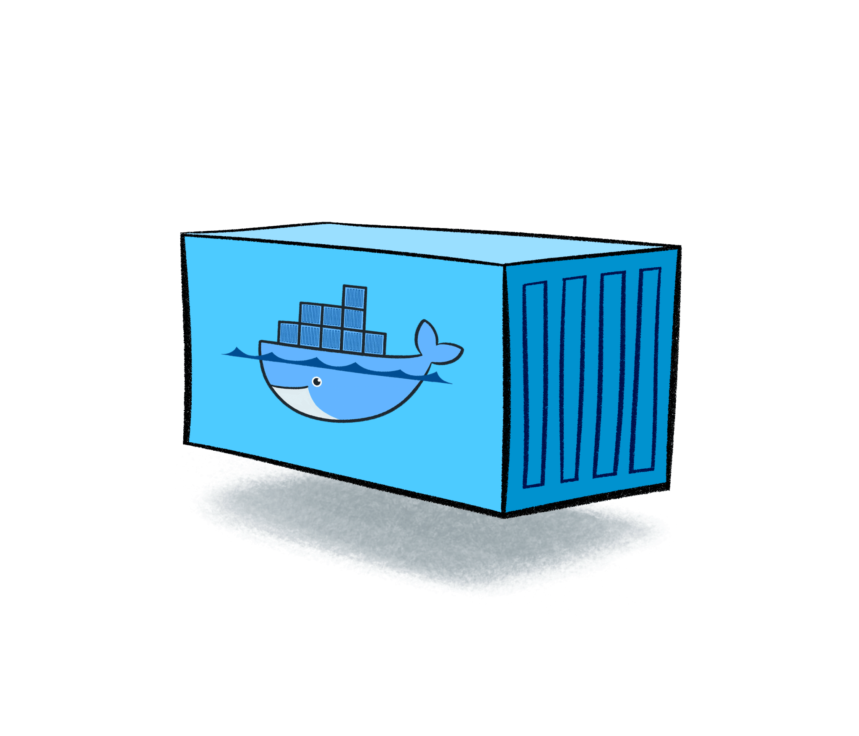
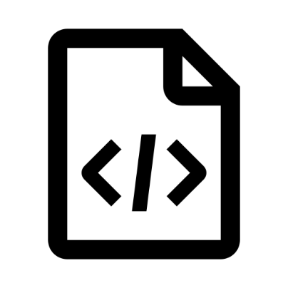
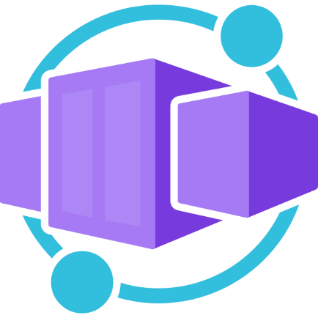
CI/CD Process
The current CI/CD process on the sandbox env
Push image
Pull image
Public access
Build, Unit test, integration test, code quality & coverage
Azure Container Apps

Slide 13
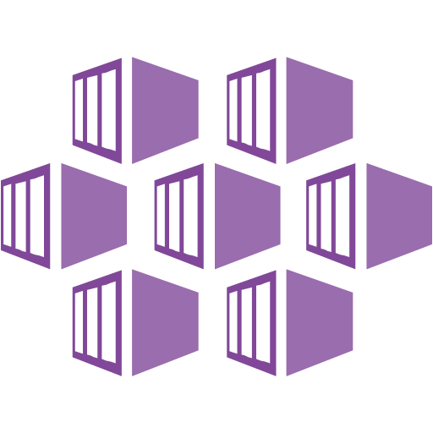
CI/CD Process
The future CI/CD process on the DCI env
Push image
Pull image
No public access
Build, Unit test, integration test, code quality & coverage (enforced)
Azure Kubernetes service

Slide 14
Quality controls
Current
Unit testing
Integration testing
Code Analysis with Sonar Cloud: bugs, code smells, vulnerabilities, code coverage (not yet enforced)
Future
Improved integration testing controls
Enforced code analysis with Sonar Cloud
Standardized CI/CD pipelines (templates)
Performance testing
Static & dynamic security testing
Infrastructure as cod (IAC) best practices & vulnerabilities scanning

Slide 15
Documentation & links
CI/CD & Environments: https://wiki.vaudoise.ch/pages/viewpage.action?pageId=417758748
Onboarding resources: https://wiki.vaudoise.ch/display/PRJ194/Dev+Onboarding

